Slide 1
Brian Cornet DSC 498 Dr. Donghui Yan Capstone Introduction
October 7th, 2020

Slide 2
Raw Image Scanner – Outline
Objectives:
Create system that accepts an image as a template and compares it to a camera image
Include generating text lists or tables, filling templates, or highlighting differences
Implement image correction for flawed camera images (skewing, reflection, warping, etc.)
Tools:
Optical Character Recognition (OCR) using libraries such as PyTesseract
Image comparison algorithms for image blocks using libraries such as PyImageSearch
Decoding algorithms for various formats (JPEG, GIF, PNG, TIF, AVI, MPEG, MP4, MOV, WEBM, etc.)
Challenges:
No formal machine learning courses until Spring 2021 (for image correction)
Physical limitations during pandemic (for experimentation)

Slide 3
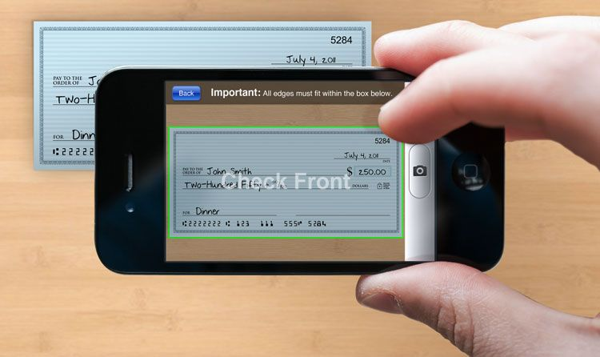
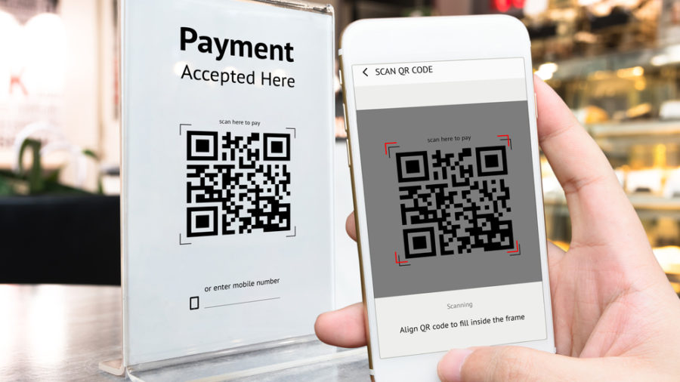
Raw Image Scanner – Concept
Comparable to commonly used technology for scanning checks, license plates, QR
Typically for specific patterns or professional usage

Slide 4
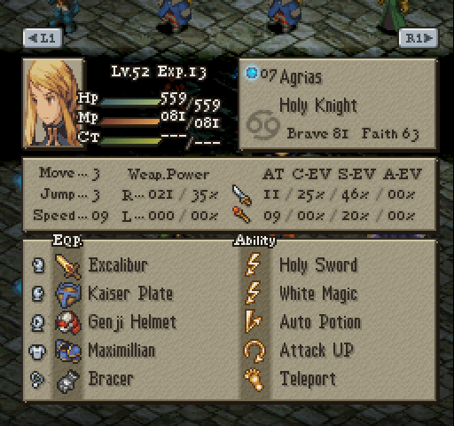
Raw Image Scanner – Design
Intended for users to collect any kind of data quickly and automatically
Ideal for when digital data doesn’t exist or can’t be easily accessed
The image for the character on the right contains 36 variables.
Without a means of accessing the raw data, a human would need to compile the visible data by hand (takes about 2-3 minutes).
What if a computer could recognize the values formed by the pixels?
Final Fantasy Tactics (Sony PlayStation)

Slide 5
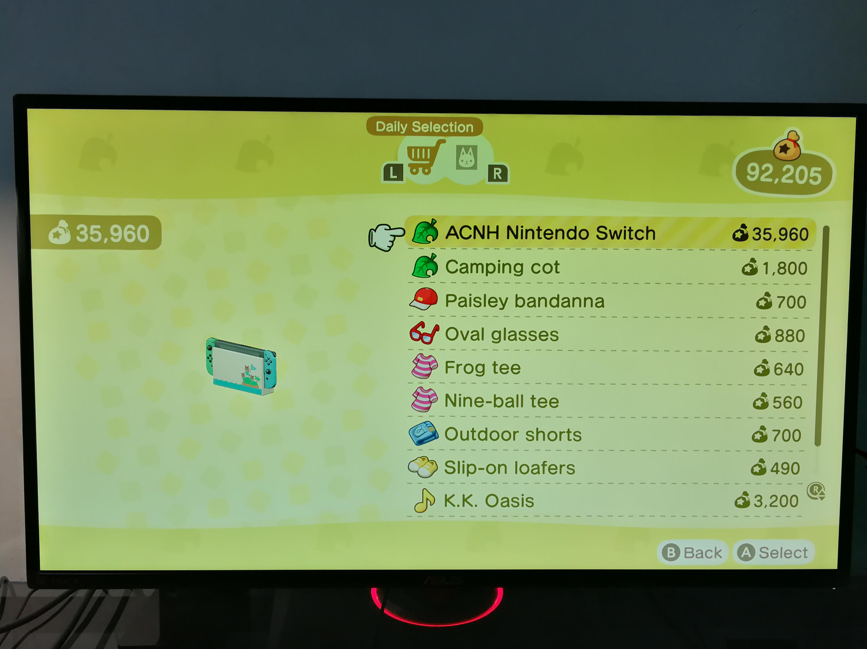
Example – Text Parsing Lists
The user inputs a screenshot containing a simple list.
The text is parsed and added to a list. New items may be added to the same list, and it may be saved or exported as needed.
* This screenshot has much more text than what was collected. It may be necessary for the user to determine a pattern to the collection process.
ACNH Nintendo Switch
Camping cot
Paisley bandanna
Oval glasses
Frog tee
Nine-ball tee
Outdoor shorts
Slip-on loafers
K.K. Oasis
Animal Crossing: New Horizons (Nintendo Switch)

Slide 6
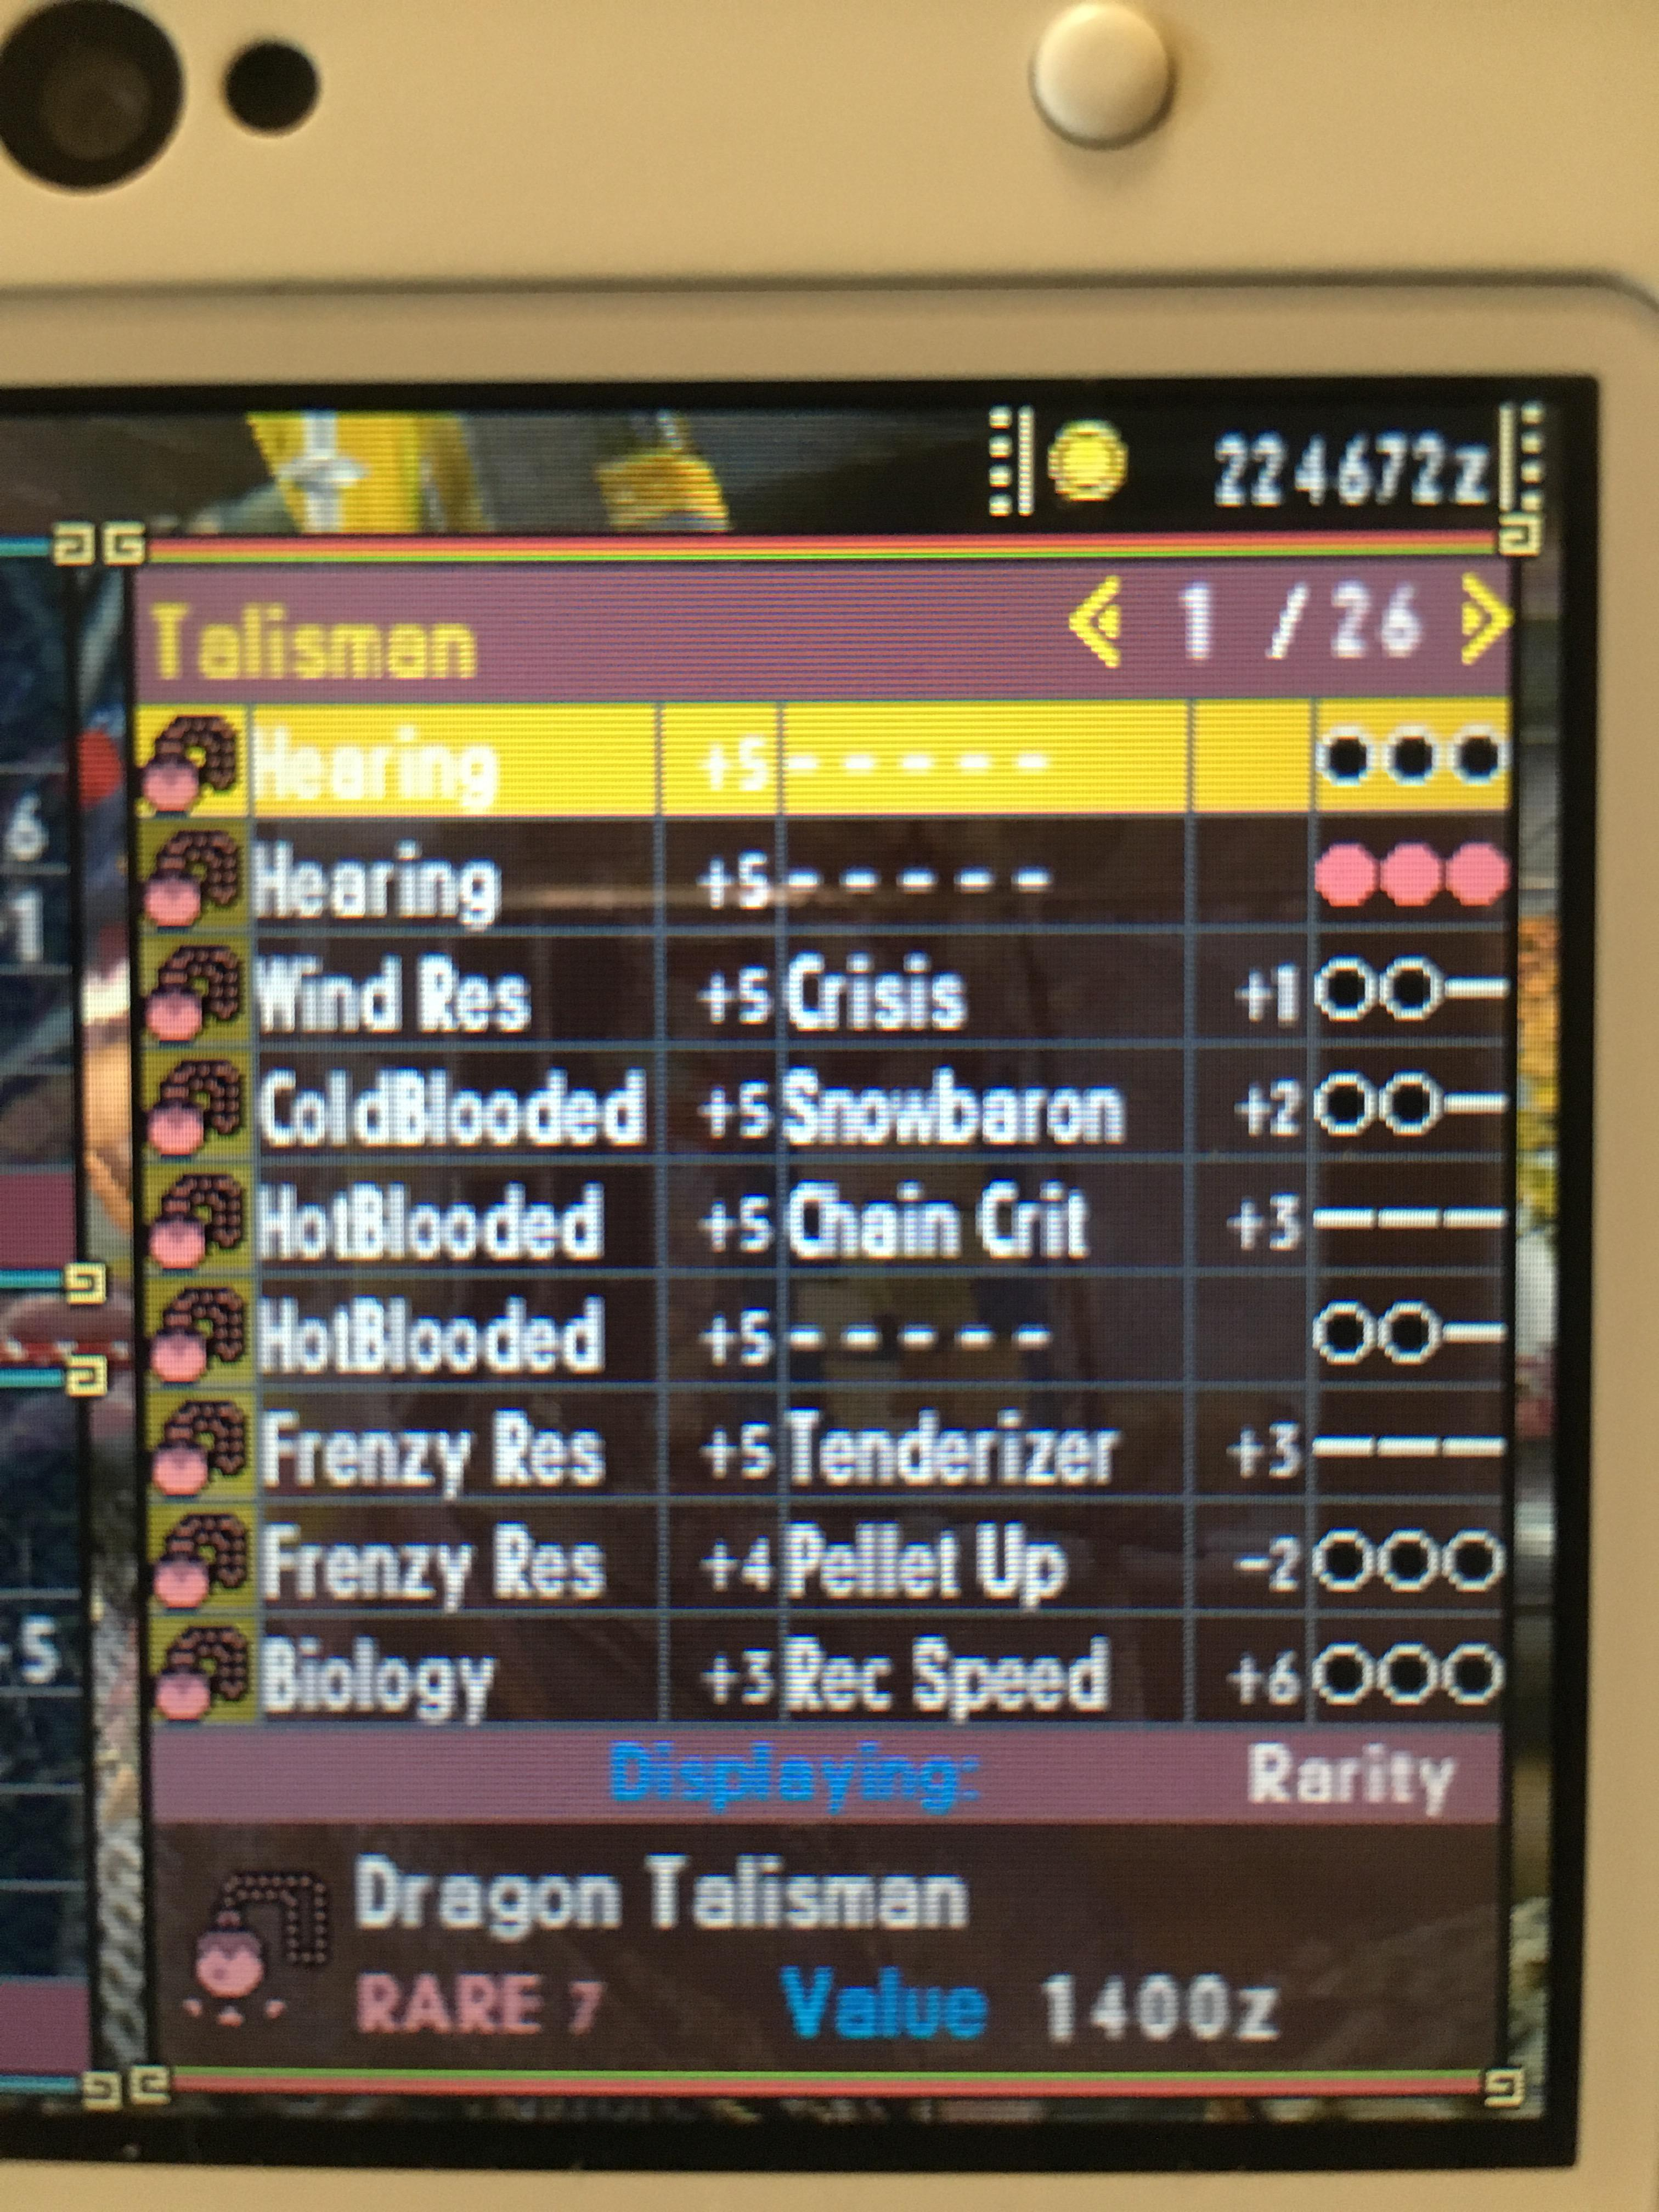
Example – Text Parsing Tables
The user inputs a screenshot containing a table.
The text is parsed and added to a table. New items may be added to the same table, and it may be saved or exported as needed.
* The top line is difficult to read, and the second line has different colors for its 5th column. Visual differences may require the user to define their importance.
Hearing | +5 | – – – – – |  | OOO
Hearing | +5 | – – – – – |  | OOO
Wind Res | +5 | Crisis | +1 | OO–
ColdBlooded | +5 | Snowbaron | +2 | OO–
HotBlooded | +5 | Chain Crit | +3 | –––
HotBlooded | +5 | – – – – – |  | OO–
Frenzy Res | +5 | Tenderizer | +3 | –––
Frenzy Res | +4 | Pellet Up | –2 | OOO
Biology | +3 | Rec Speed | +6 | OOO
Monster Hunter Generations (Nintendo 3DS)

Slide 7
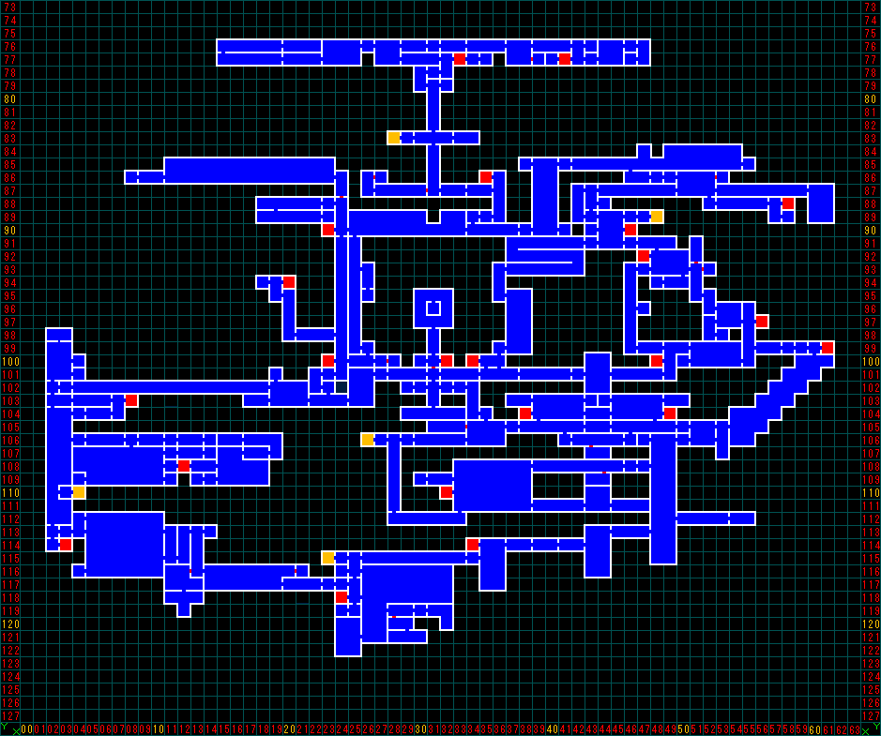
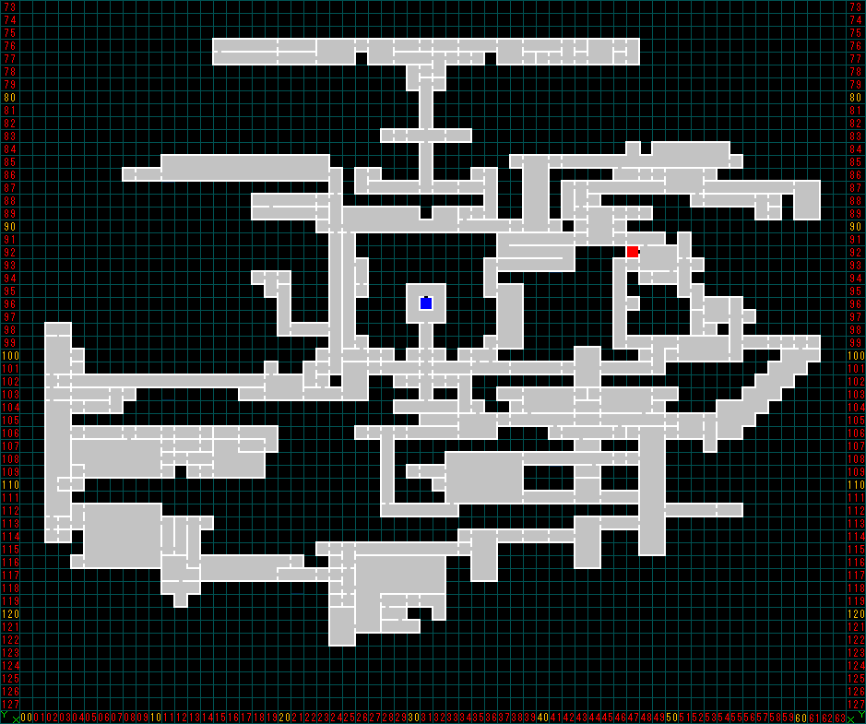
Example – Find Differences in Matrices
The user inputs a screenshot of a map they’re exploring A. They know they’re missing two squares but don’t know which.
An image of the completed map B is provided to compare against. A must be skewed to fit a similar shape.
The missing two squares are identified based on the differences between the two images, or B – A.
Castlevania: Symphony of the Night (Sony PlayStation)

Slide 8
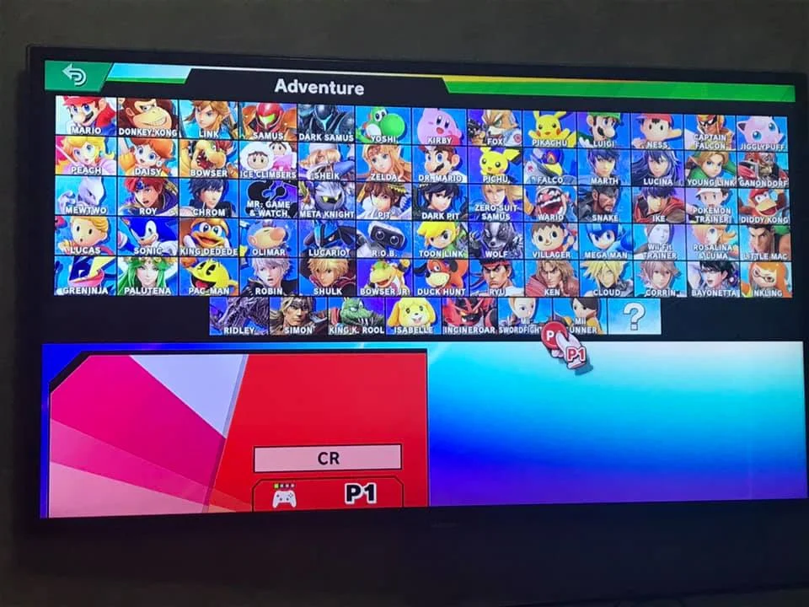
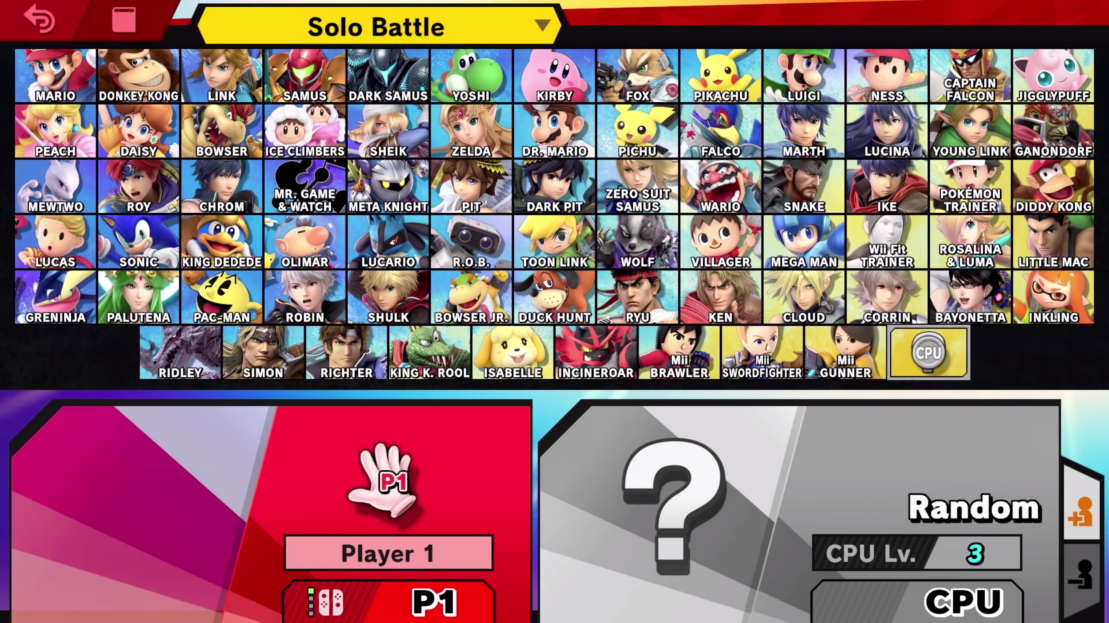
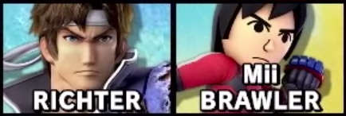
Example – Find Differences in Sets
The user inputs a screenshot of a screen that changes its structure, adding every character’s name/portrait to a partial list A.
The missing characters are identified based on what’s in the complete list but not the partial list, or B – A.
A screenshot of the final roster is added next, which creates the complete list B.
Super Smash Bros. Ultimate (Nintendo Switch)

